Slide 1
GitHub Repositories
Module A.1

Slide 2


What Is A Code Repository?
A code repository is similar to other cloud based file sharing services.
Google Classroom / Docs
D2L, MyClass, etc.
A code repository is optimized for sharing and maintaining computer program code and collaborating on code development.
Files have version control (can be easily rolled back to older version)
Files are submitted using "commit update" (user id and timestamp)
File changes are therefore easily tracked and managed
Interface is designed for efficiency (no fancy display options or tools)
Most file types can be stored (including Word and PowerPoint) but must be downloaded and viewed locally
A code repository lacks the on-line editing tools provided by other services
Does not include many of the business / education related collaboration tools

Slide 3

Why GitHub?
GitHub is a professional code repository service.
Most popular service in the software development community
Free to use and publically available (e.g from Home or Library)
Used by many independent developers to release and distribute their software
Many game map editors, game mods, and patches are on GitHub
Many custom tools and utilities for Android / Windows are on GitHub
I will share my GitHub repository with you to distribute course materials.
Bookmark: https://github.com/Greg5519/ICS2O0-B
You will create your own independent GitHub repository to manage your coursework.
You will create your own account and repository with GitHub
You will share a link to your repository with me (send me an email)
You will upload work to your repository to be marked by me and given credit for the course
Returning Students… Create a new repository for this course

Slide 4
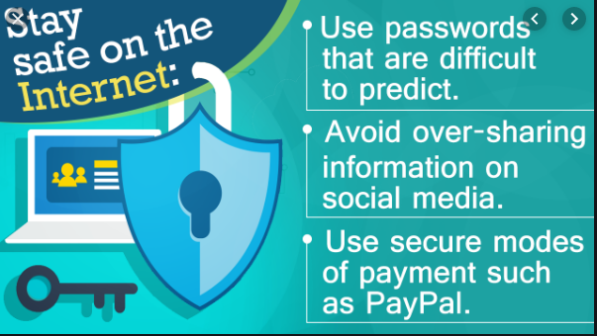
What Are Some Privacy Concerns?
GitHub is a publically accessible service.
Your account profile is visible to anyone on the web
Content you upload to your repository is visible to anyone on the web
Be Aware Of What You Share!
Guidelines you should follow when creating your student account:
You may (should) use your @pdsb.net email account for contact information
You SHOULD NOT use your @pdsb.net email account as a user ID
Use an ID that is somewhat "fake" but that is meaningful for this course
Do not use your real (full)name
Do not share your birthday, address, etc.

Slide 5


"Terms of Service" and "Privacy Policy"
A Terms of Service Agreement (TOS)
Defines proper and expected use of the service
Defines what is misuse of the service
Outlines membership, subscription and payment details
Outlines the procedure for closing an account
Clarifies the legal liability and dispute resolution process
A Privacy Policy
Discloses what personal information about you is collected and stored
Outlines how and when your personal information is collected
Defines who your personal information is shared with
The difference between a TOS and Privacy Policy
A TOS protects the company from you
Is not required by law but put in place for the benefit of the company
A Privacy Policy protects you from the company
Is required by law not because the company wants it

Slide 6
Your Turn
Open your web browser to:
Grade 10s: github.com/Greg5519/ICS2O0-B
Grade 11s: github.com/Greg5519/ICS3C0-A
Grade 12s: github.com/Greg5519/ICS4C0-A
Bookmark this link as the "ICSxxx Course Repository"
Open the "Topic A" folder and download the "A.1 Student" File
Save the "A.1 Student" as your own copy in your documents folder on the school network.
Open the file and start typing your answers to the questions starting below "Module Questions" (on page 3)
Save often to protect your work!

